Slide 1
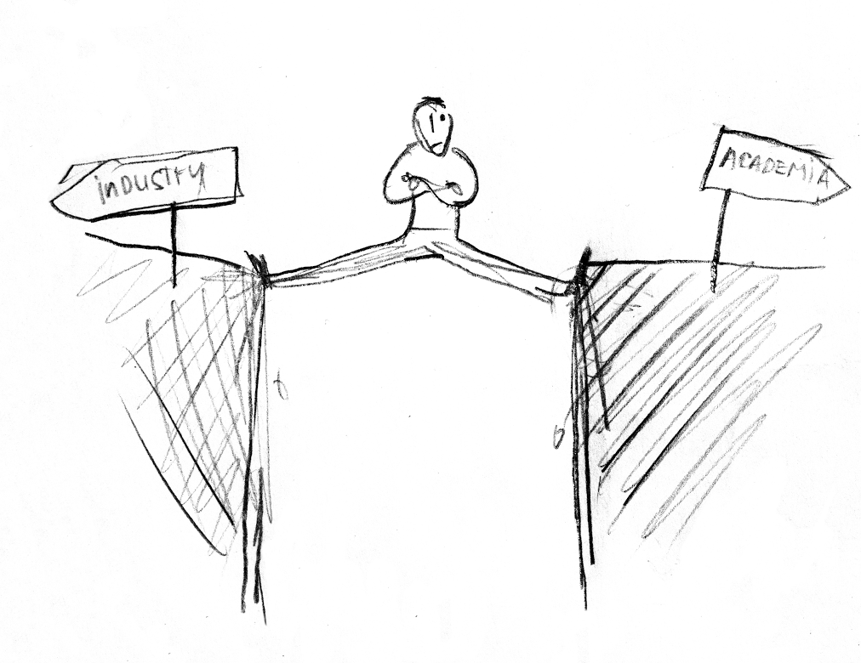
Academia and Industry
Moving back and forth?
Marcel Haas, NAC 2024
Image by Yasas Mahima

Slide 2
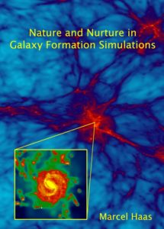
My time in astro

Slide 3
My path since
ML, data science
From analyst to team lead
Consultant, data scientist, trainer
Realization that I miss academia
Policy for higher education
Want to see more of the world!
Best Plan B?
Commercial environment
Assistant professor
Or Plan A!
2013
2018
2021
2023

Slide 4
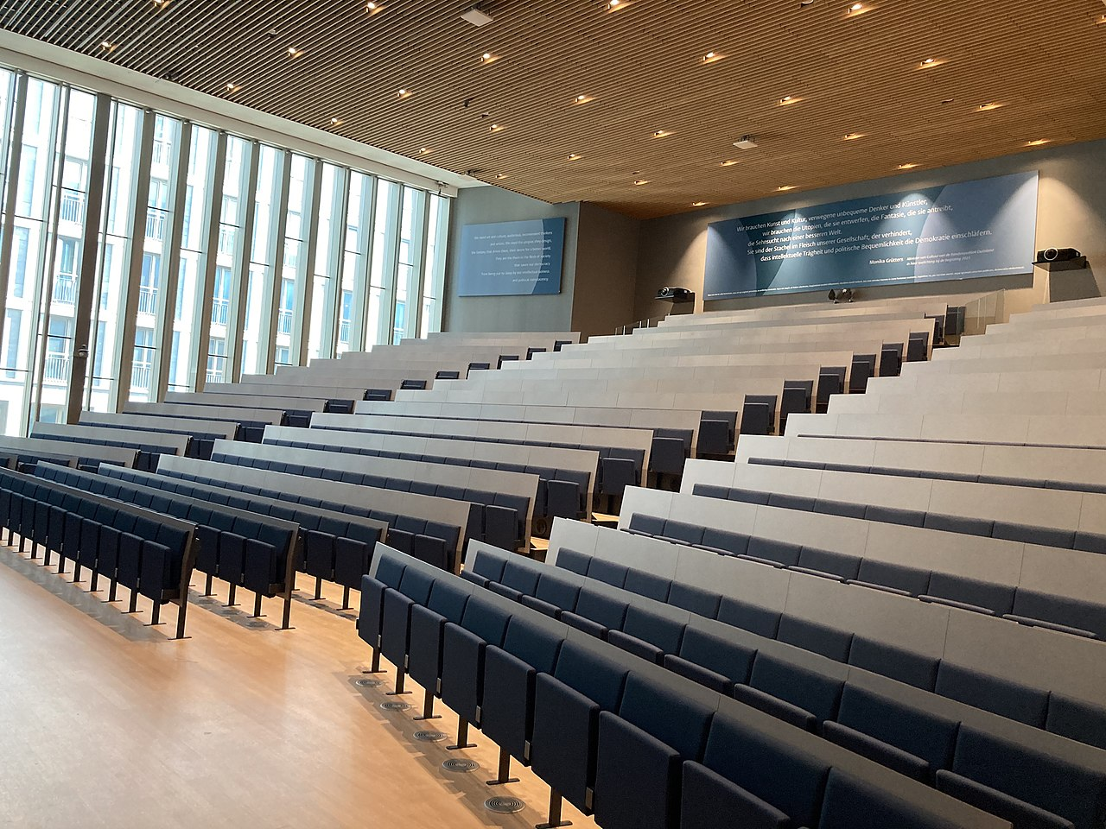
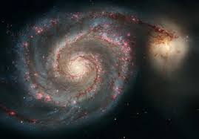
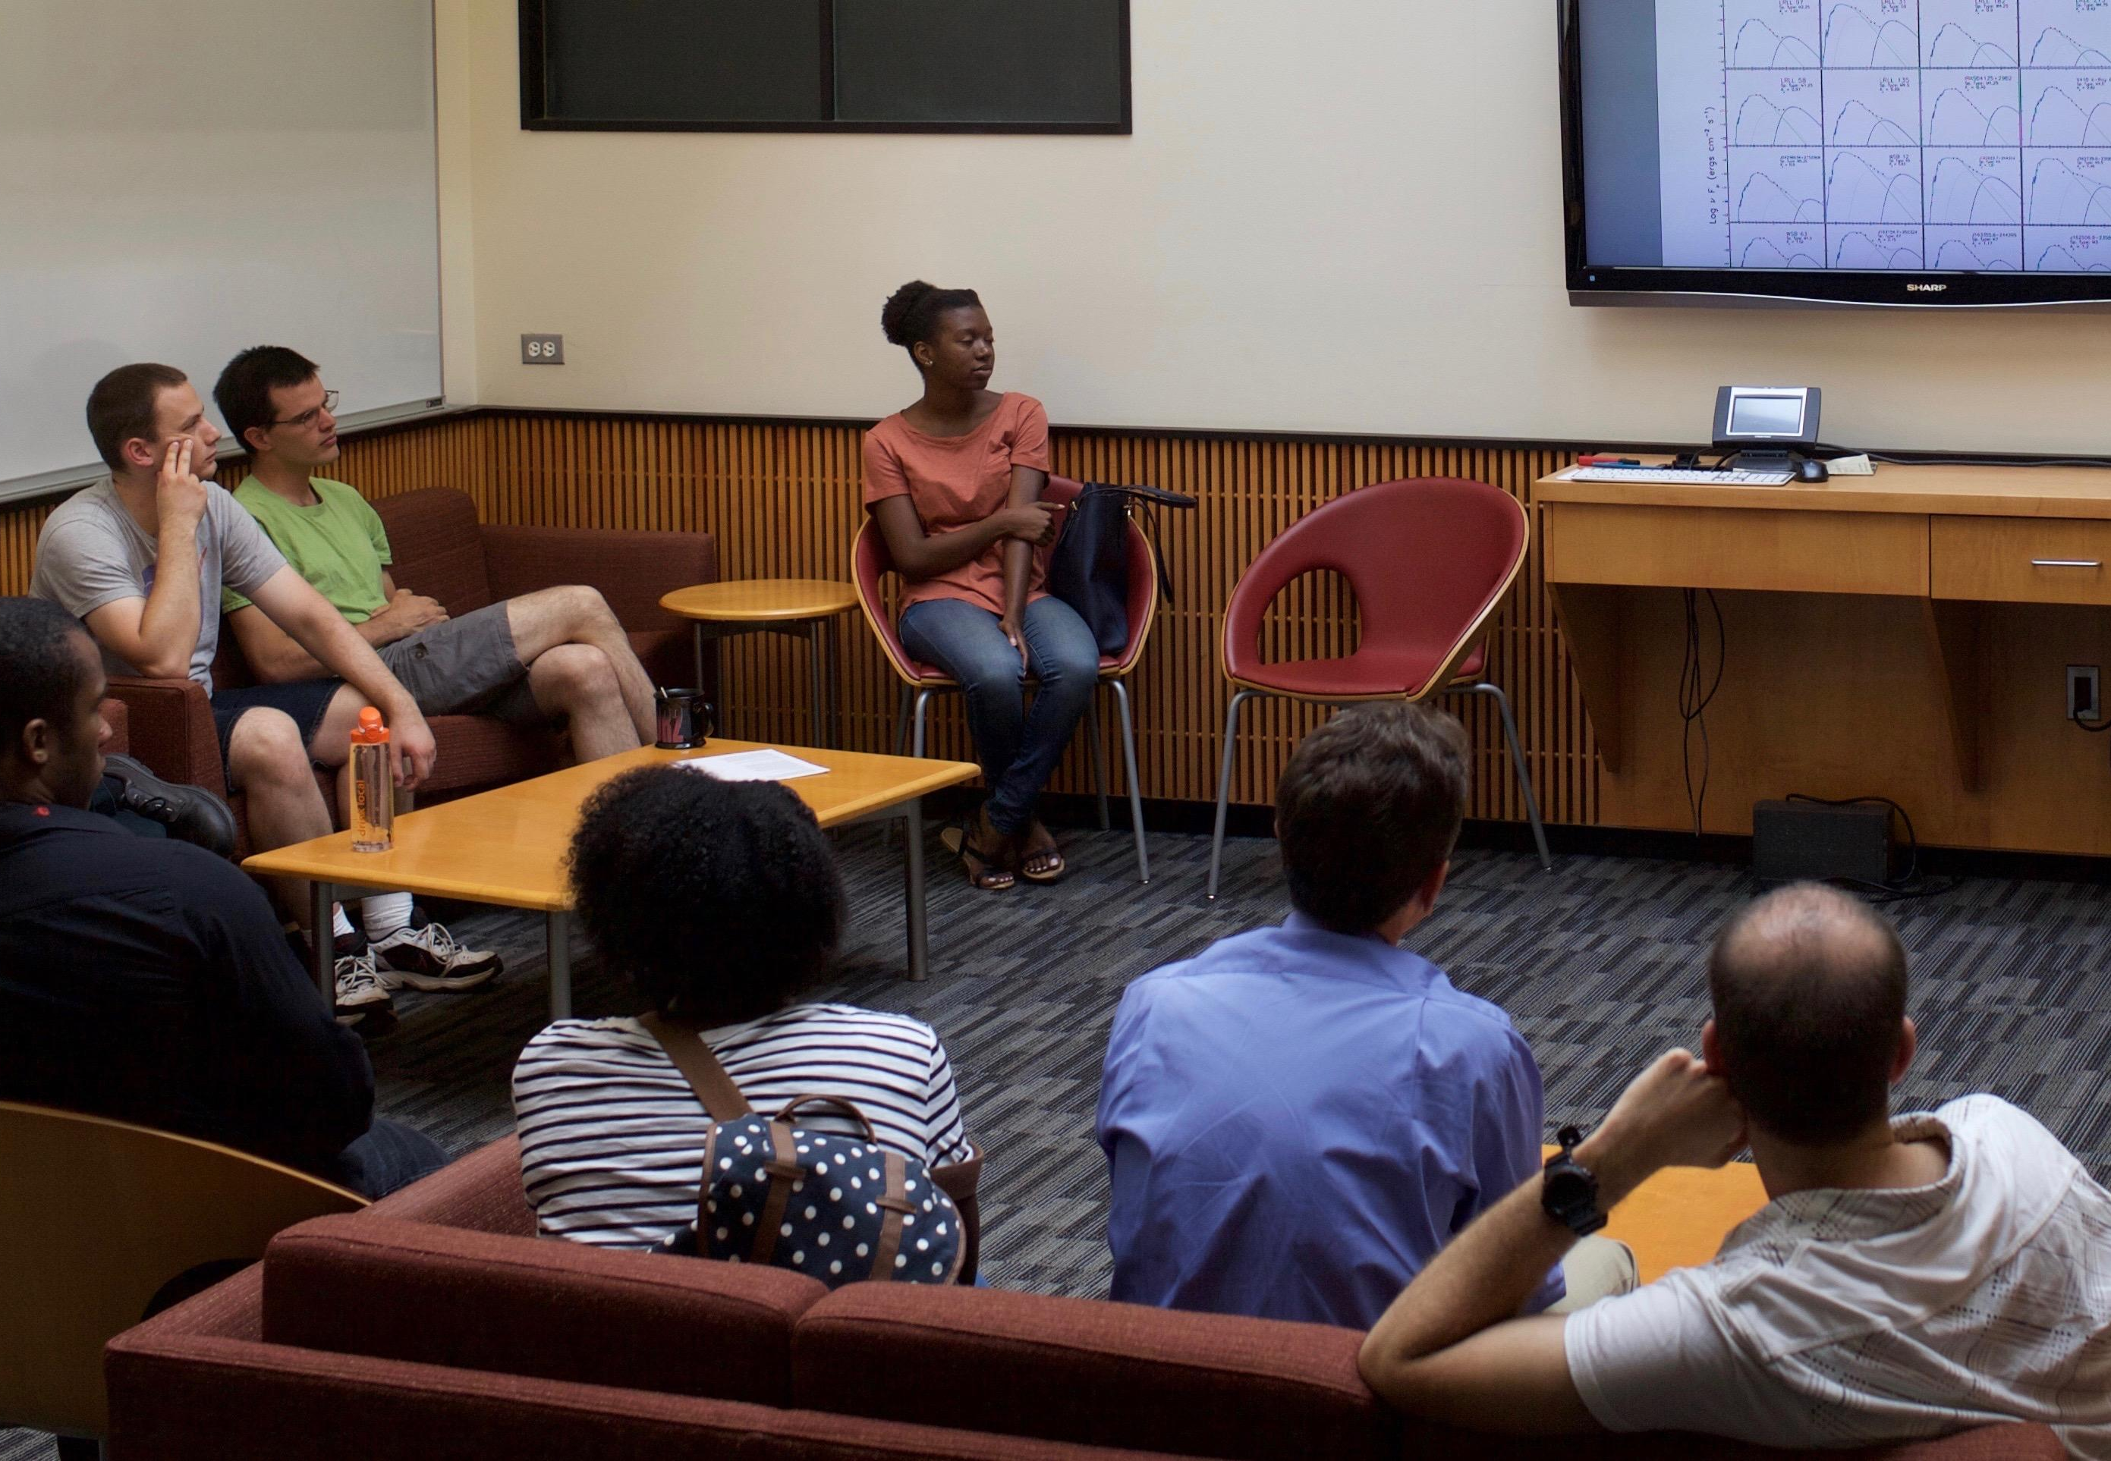
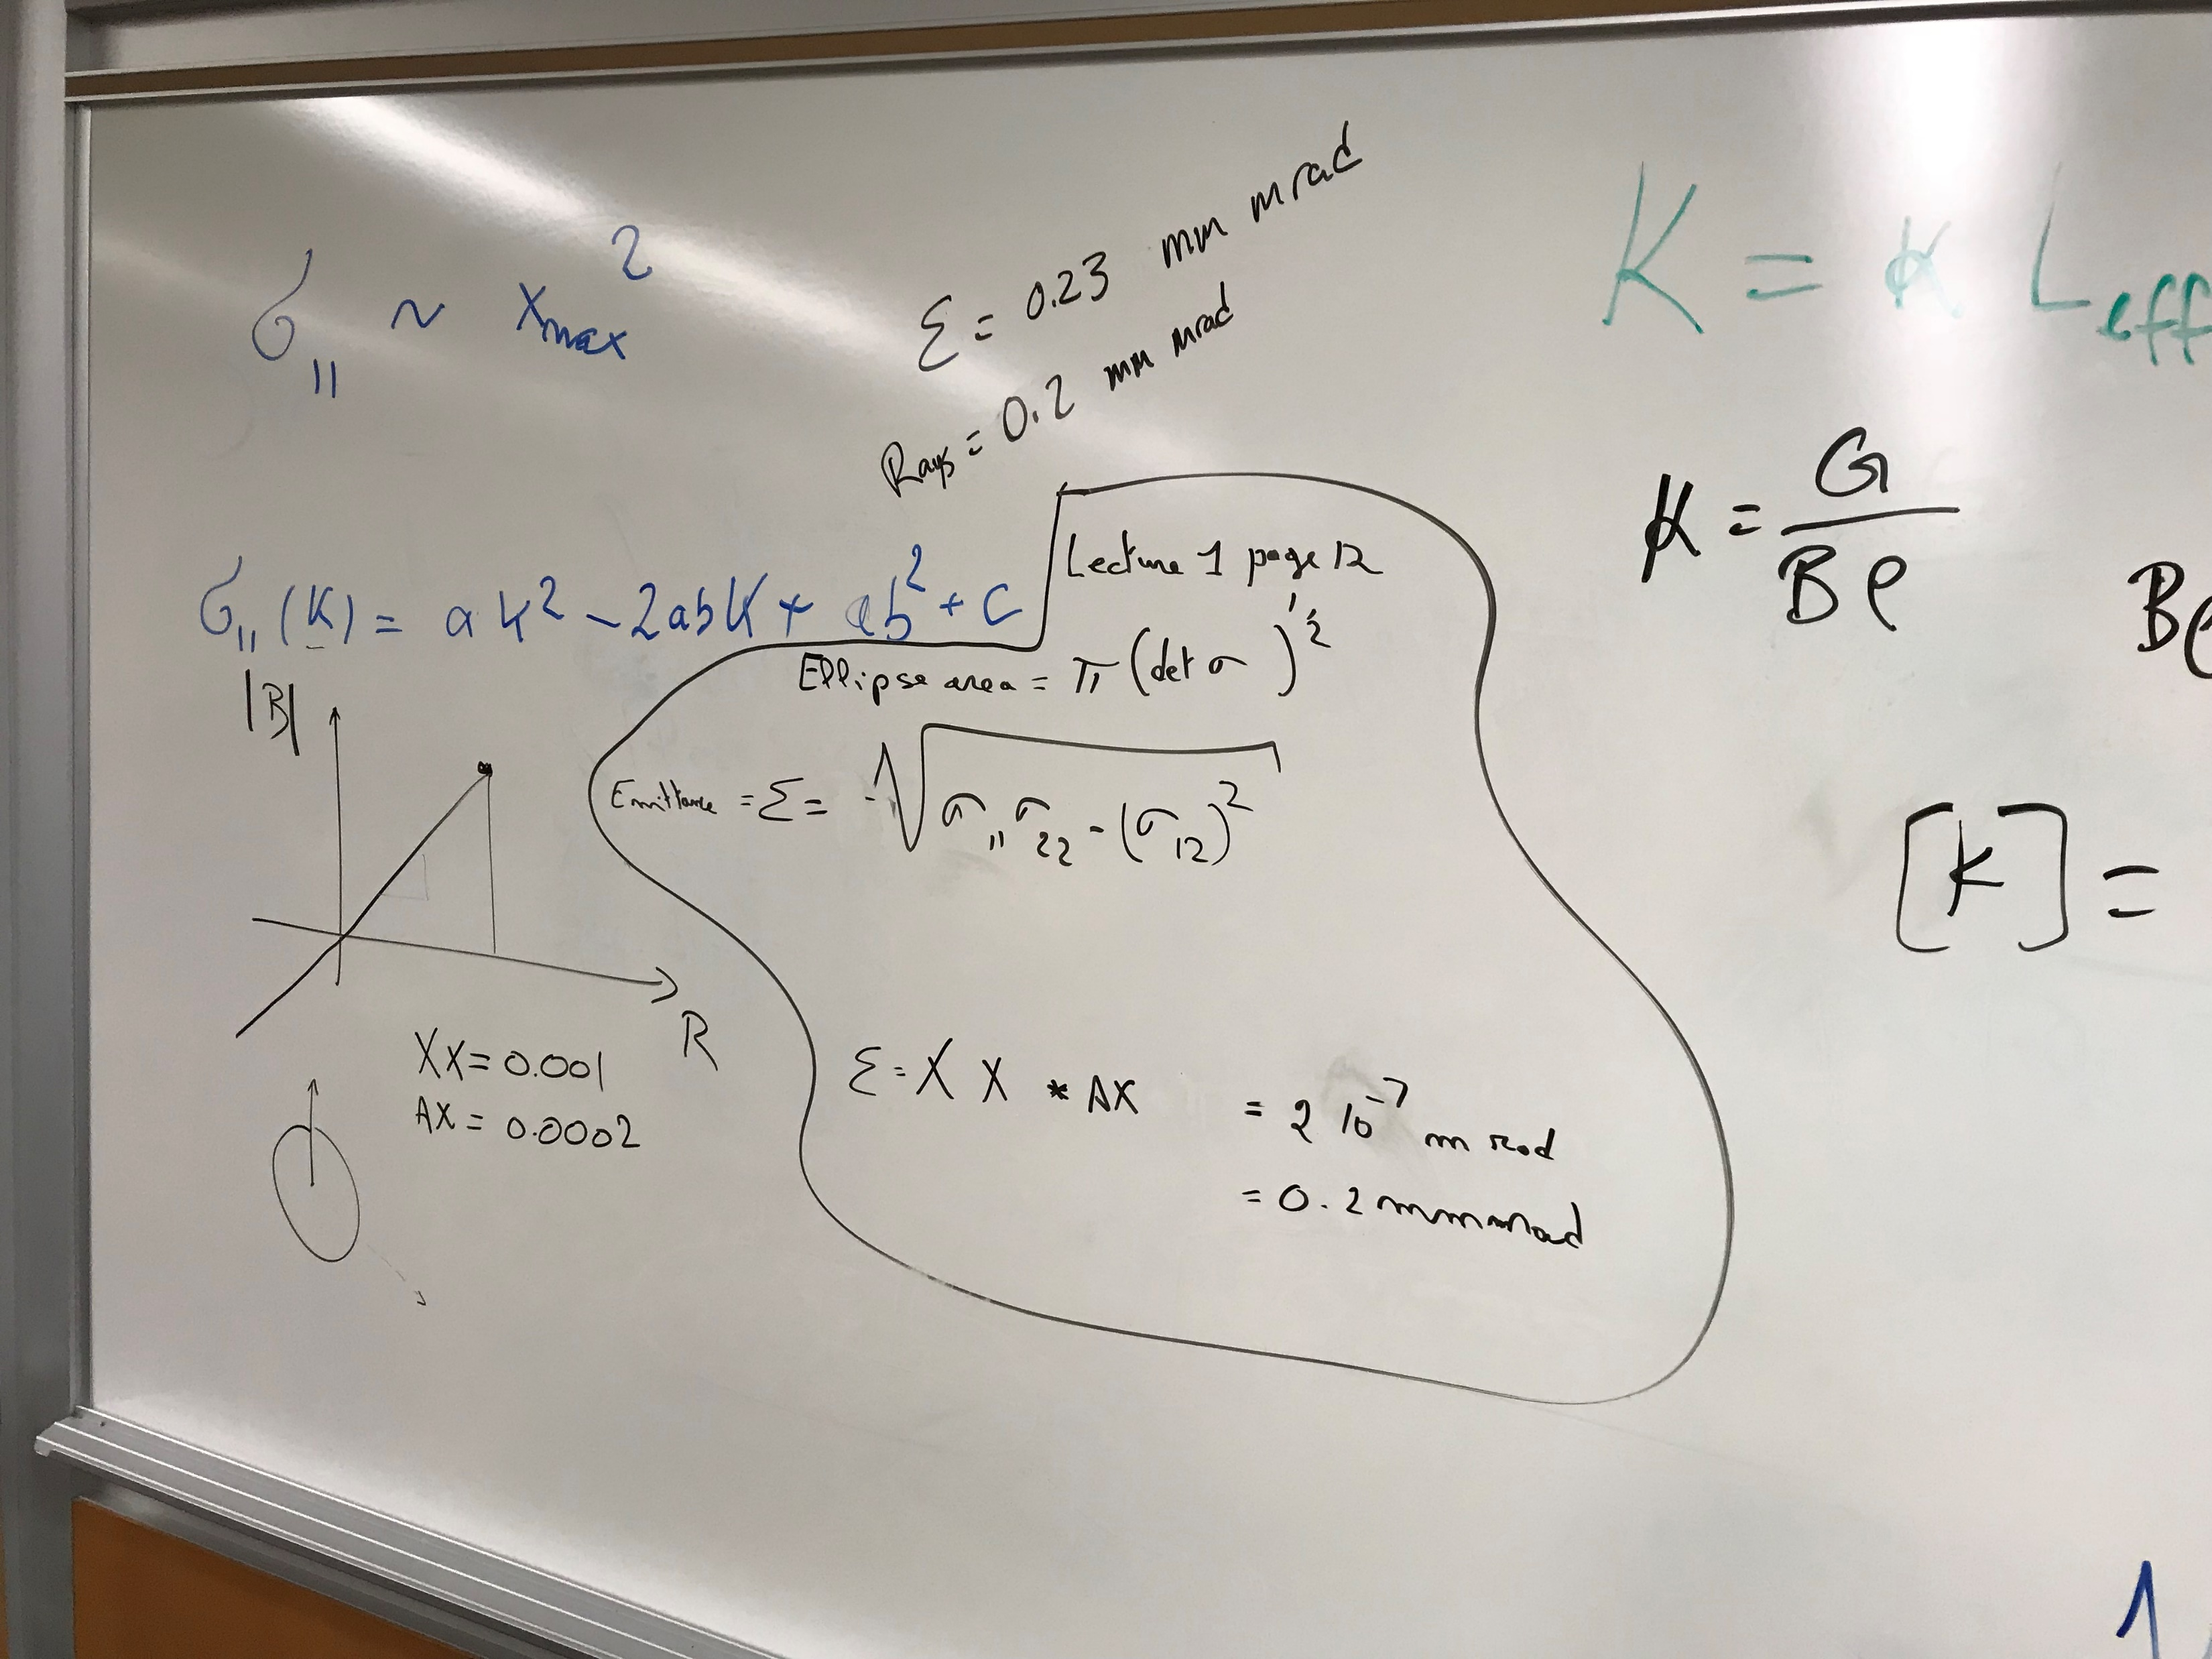
Missing Astro or Missing Academia?

Slide 5
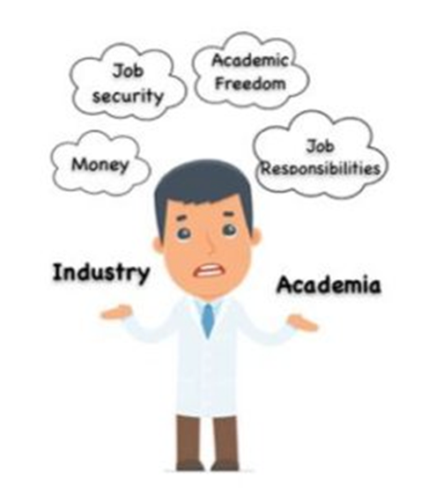
When considering the switch, consider your motives
Why would you switch?
What do you enjoy and would you rather keep?
What do you dislike and want to see change?
These considerations should also help you find a suitable place in “industry”, or elsewhere

Slide 6
Reach out!
NSKIES mentoring program
Astro2DS / Astronomers turned data scientist (Slack + podcast/youtube)
LinkedIn, Bluesky, Mastodon
mail@marcelhaas.com
Keep spending time on hobbies, too!

